Slide 1

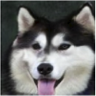
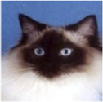
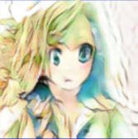









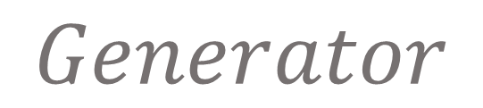









$$E_{s}^{n}$$
$$w_{n}E_{s}^{n}$$
$$a_{n}$$
Down-sampling
Residual Blocks
$$E_{s}^{2}$$
$$w_{2}E_{s}^{2}$$
$$a_{2}$$
$${Encoder E}_{s}$$
$$E_{s}^{1}$$
$$w_{1}E_{s}^{1}$$
$$a_{1}$$
$$Encoder$$
$$Feature Map$$
$$Attention$$
$$Feature Map$$
Fully Connected
Fully Connected
$$W_{n}$$
$$W_{2}$$
$$Auxiliary Classifier η_{S}$$
$$W_{1}$$
$$γ,β$$
Residual Blocks
Up-sampling
$$Generator$$
$${Decoder G}_{t}$$

